Slide 1

Marketing campaing analysis
FILIPE CHAVES DE MACEDO

Slide 2
INTRODUCTION
In order to reach the objective of helping the marketing department to spend its yearly budget in a more assertive way a brief case study based on past campaigns was elaborated, with the purpose to know the customers and also to point some insights that may be useful.
Main topics on the next slides:
Past campaigns overview;
Customer’s profile;
Customer segmentation – RFM;
Customer segmentation – Kmeans;
Predictive model to improve de campaign’s profit;
Conclusions.

Slide 3
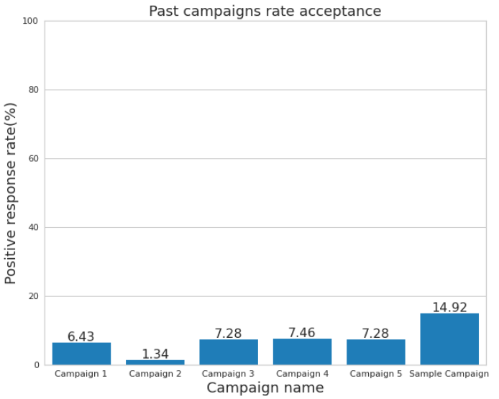
PAST Campaigns ANALYSIS
In the chart below we can see the rate of positive responses in each campaign already carried out A number of 2240 responses were analyzed and the campaign with the highest sales conversion rate was the Sample Campaign with a percentage of 14,92%. This data makes us to visualize that the effectiveness of the campaigns have been extremely low.
ATTENTION POINT:
In the sample campaign the marketing department spent 6.720MU and the revenue generated was 3.674MU, globaly the campaign had a profit of -3.046MU.

Slide 4
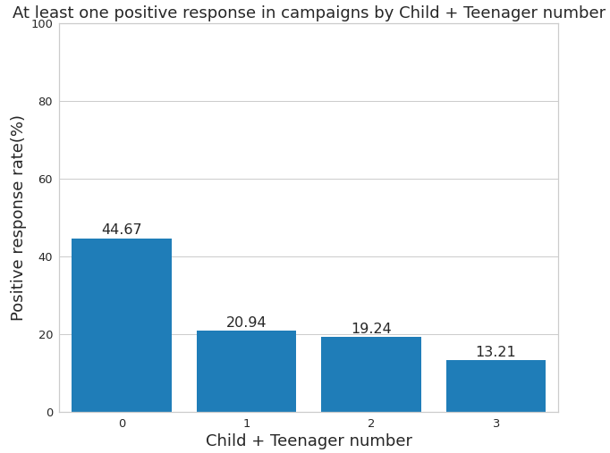
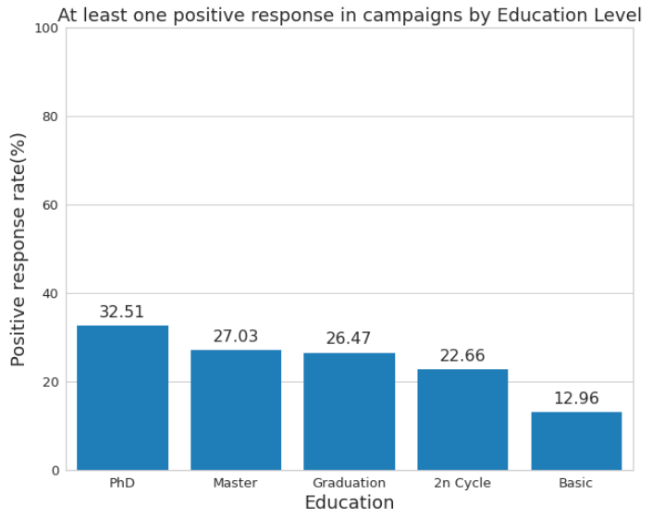
CUSTOMER’S PROFILE
Trying to better understand the profile of consumers, who accepted at least one offer in the past campaigns, we analyzed the percentage of positive responses considering some characteristics as we can see below:
An interesting characteristic that can be seen with this analysis is that customers who do not have children or teenagers at home accepted offers from past campaigns in a greater proportion if compared with people who have one or more children or teenagers at home. Another interesting point is that people with a high education level accepted the past campaigns in a great proportion if compared with low education levels.

Slide 5
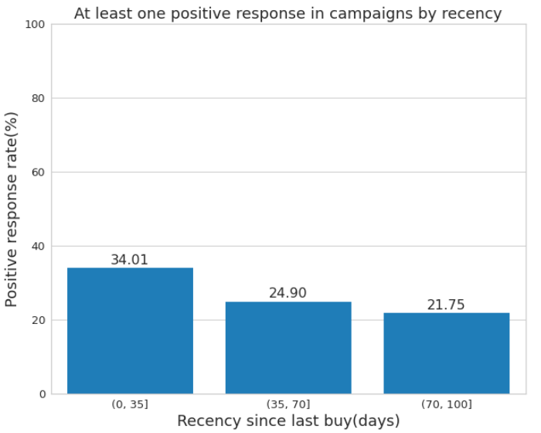
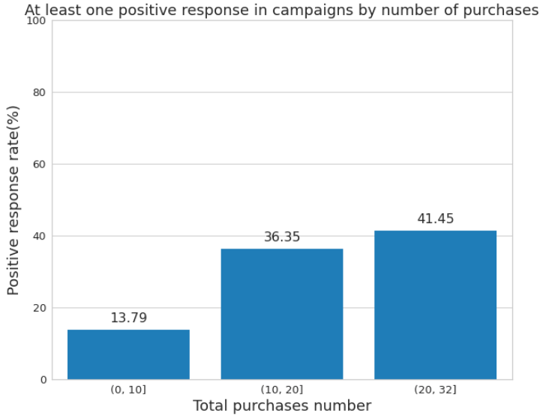
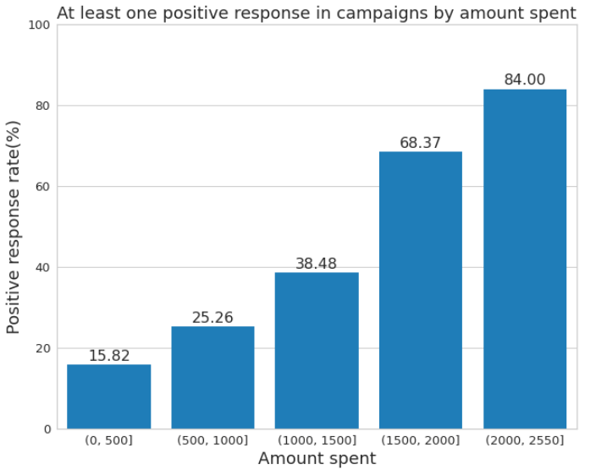
CUSTOMER SEGMENTATION - RFM
In the charts below, we can see that customers who bought more recently, more frequently and who spent more shopping have in common the characteristic of accepting marketing campaigns at a higher rate.
Based on this information we will perform a customer segmentation using the RFM(Recency, Frequency, Monetary) method which is based on how recently, how often and how much a customer has purchased, from these three variables the customer receives a score that will define which group they will be allocated to.

Slide 6
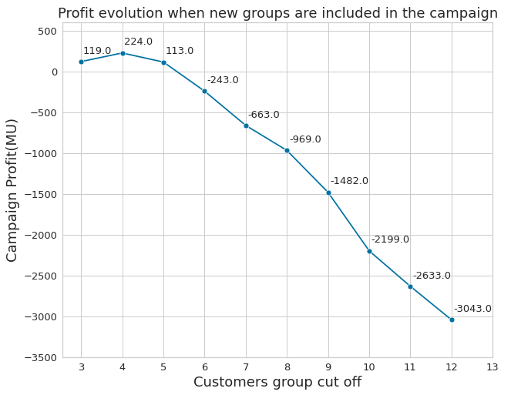
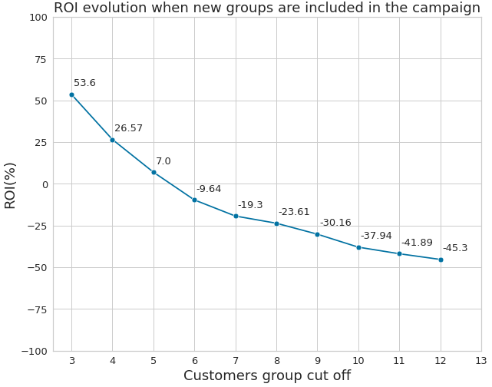
CUSTOMER SEGMENTATION - RFM
Using the RFM segmentation ten customer groups were created, from the best score(3) to the worse score(12), starting with the best score we included group by group in the campaign analyzing the impact in two main factors: Profit and the ROI(Return Over Investment).
If just the groups with scores 3 and 4 are included in the campaign we can reach our best profit in 224MU;
The best ROI of 53,6% is when we have just the customers with score 3 being contacted.

Slide 7
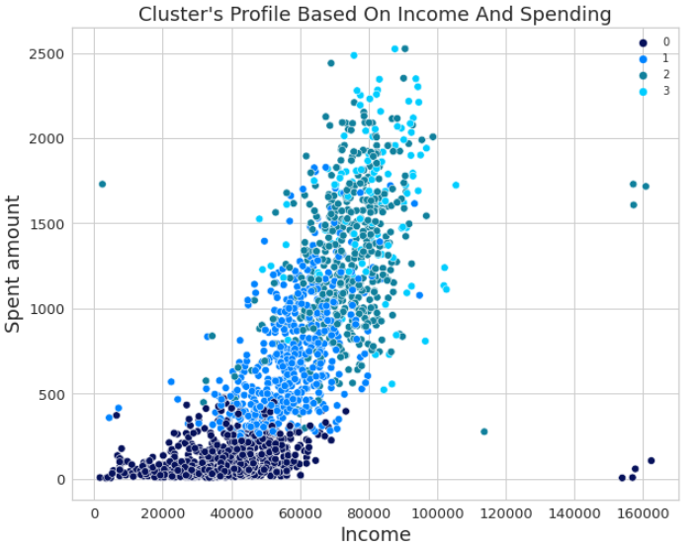
CUSTOMER SEGMENTATION - KMEANS
Another method used to segment customers was the KMeans, which is able to separate samples in n groups of equal variance. According to the method used, the best number of groups to segment customers is four.
Group number | Customers in the group | Campaign cost (MU) | Sold gadgets | Campaign revenue (MU) | Profit (MU) | ROI(%)
0 | 1038 | 3114 | 91 | 1001 | -2113 | -67,85
1 | 579 | 1737 | 70 | 770 | -967 | -55,67
2 | 501 | 1503 | 94 | 1034 | -469 | -31,20
3 | 121 | 363 | 79 | 869 | 506 | 139,39
We can see that among the four groups, only one showed a positive return of 506MU, where 121 customers were contacted and 79 gadgets were sold. If the campaign was made only with users in this group, the ROI would be 139,39%. Analyzing the characteristics of this group we have an idea of what makes it different from the others this group has higher medians in income, total spend, number of purchases and positive responses in previous marketing campaigns. We noticed that most of the clients in the group don't have children or teenagers at home

Slide 8
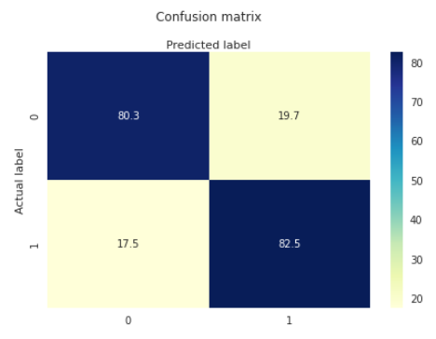
Predictive model
In the prediction a Logistic Regression was implemented to make classification between customers who will accept the campaign offer in the next campaign. The model correctly predicted 82,5% of the customer who would accept the offer and 80,3% who wouldn’t accept the offer on the sample campaign.
Campaign based on users selected by the prediction model:
Customers contacted | Campaign cost (MU) | Sold gadgets | Campaign revenue (MU) | Profit (MU) | ROI(%)
651 | 1953 | 275 | 3025 | 1072 | 54,88
Campaign succes rate increased from 15% to 42,24%;
Profit increased from -3046MU to 1072MU;
Campaign budget decreased from 6720MU to 1953MU;
Gadgets sold decreased from 334 to 275 units.

Slide 9
CONCLUSIONS
Customers more likely to accept the campaign offers have the key characteristics:
Less children or teenagers at home;
Higher education level;
Buy with a high frequency;
Spend more buying;
Higher incomes.
Segmentation showed to be a reasonable method:
RFM can improve the profits to 224MU;
Kmeans was the best segmentation improving the profits to 506MU.
Classification using the Logistic Regression model increased the campaign succes rate to 42,24% and sold 275 gadgets improving the profit to 1072MU, saving a lot of costs reducing the time spent contacting customers.
The data-driven approach showed a lot of good insights about the customers and proved that analyzing the data we can find good ways to reduce costs and improve profits.

